Slide 1
Bring RoCE (RDMA over Converged Ethernet)
Capability to Virtio-net Device
Yongji Xie
ByteDance STE Team
KVM Forum 2022

Slide 2
Agenda
Background
Design & Implementation
S
Status & Future Work

Slide 3
Background
S

Slide 4
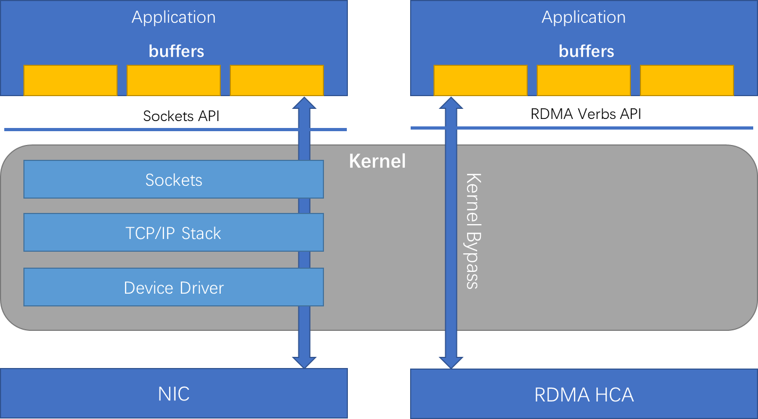
RDMA Introducation
RDMA (Remote Direct Memory Access)
Enables two computers to exchange data in main memory throught network without involving either one’s CPU and operating system.

Slide 5
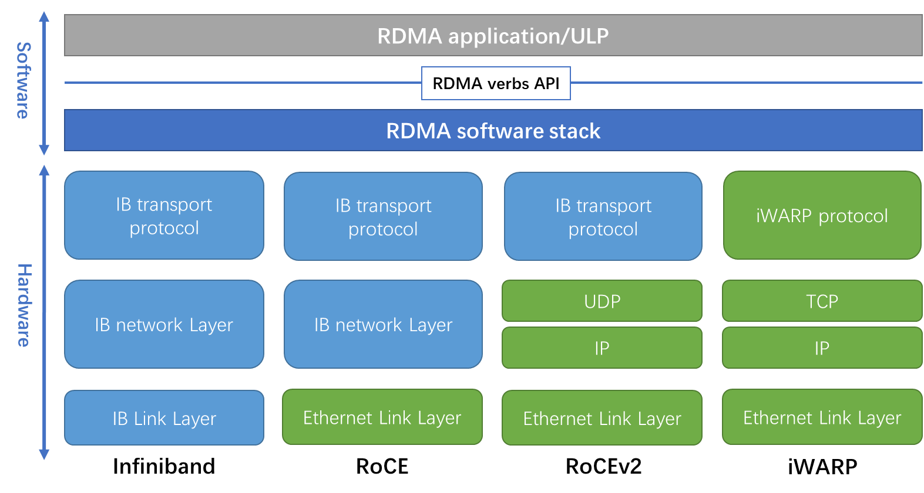
RDMA Introducation
RDMA (Remote Direct Memory Access)
Enables two computers to exchange data in main memory throught network without involving either one’s CPU and operating system.

Slide 6
RDMA Introducation
RDMA (Remote Direct Memory Access)
Enables two computers to exchange data in main memory throught network without involving either one’s CPU and operating system.
RoCE (RDMA over Converged Ethernet)
RoCE v1: Ethernet link layer protocol
RoCE v2: Internet layer protocol which exists on top of either the UDP/IPv4 or the UDP/IPv6 protocol

Slide 7
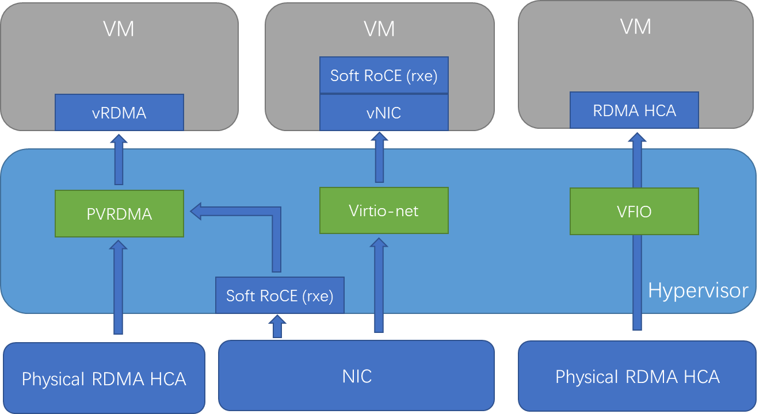
RDMA in Virtualized Environments
VFIO Passthrough
Passthrough a VF of RDMA HCA to VM
Soft RoCE in VM
RXE kernel module
Software implementation of RoCE protocol based on the normal NIC
PVRDMA
A paravirt driver in VM and a paravirt device in hypervisor
Backends can be a VF/PF of physical RDMA HCA or a Soft-RoCE (rxe) device

Slide 8
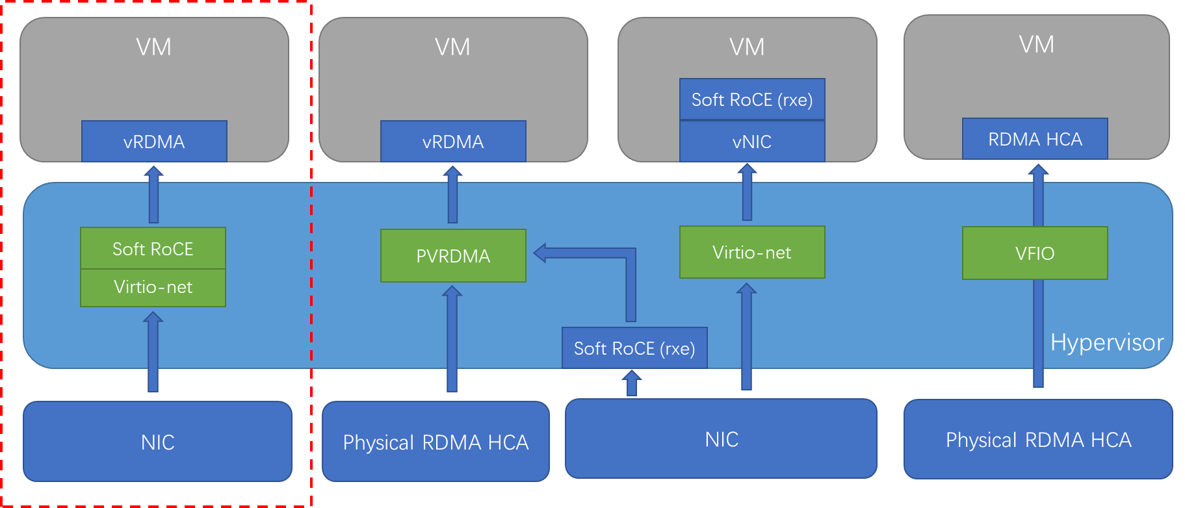
Enable RDMA on virtio-net device

Slide 9
Comparision
 | Performance | Flexibility | Maintainability
VFIO Passthrough | High Full HW RDMA acceleration | Medium Strong dependency on HW | Low Strong dependency on HW Live migration support with some HW assistance
PVRDMA | Medium Bypass guest kernel HW RDMA acceleration | Medium Dependency on HW or soft roce kernel module in host | Medium Live migration support with some HW assistance
Soft RoCE in VM | Low Can’t bypass anything | Low Dependency on soft roce kernel module in guest | Medium RDMA Logic is in guest kernel Live migration support
RoCE on Virtio-Net | Medium Bypass guest kernel DPDK acceleration | High Full software implementation Easy to do feature extension | High Full software implementation Live migration support

Slide 10
Design & Implementation
S

Slide 11
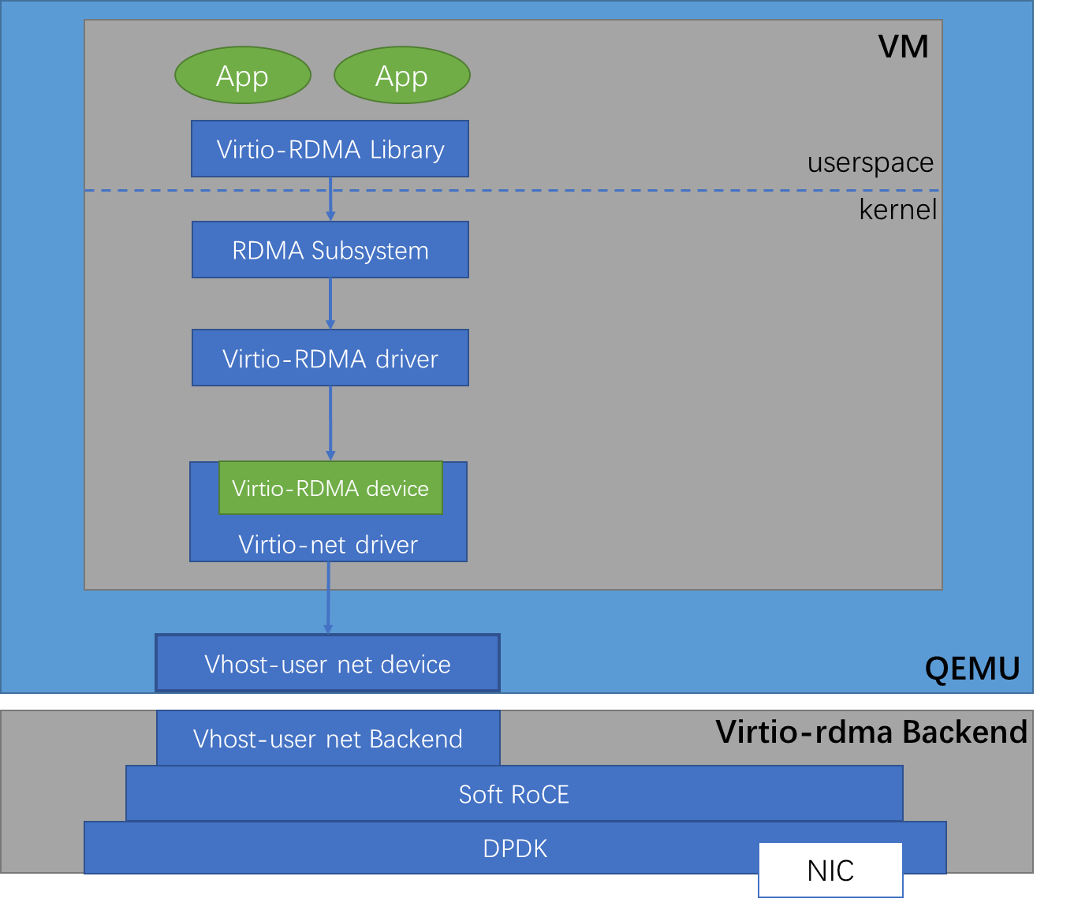
Architecture Overview
Virtio-RDMA Library
A provider in libibverbs
Communicate with virtio-rdma backend directly in data path
Communicate with kernel RDMA subsystem via /dev/infiniband/uverbsX interface in control path
Virtio-RDMA Driver
Communicate with virtio-rdma backend in control path
Virtio-RDMA Backend
Soft RoCE implementation
Vhost-User backend
DPDK acceleration

Slide 12
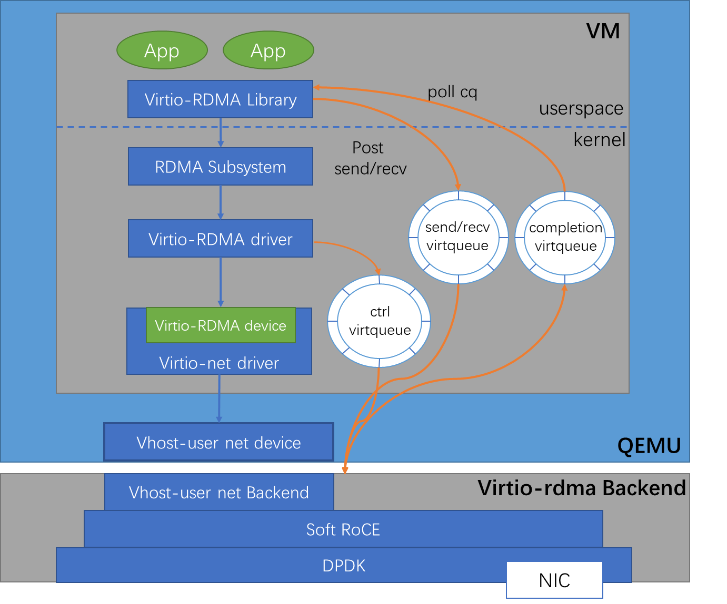
New Virtqueue Types
Control Queue
Reuse virtio-net ctrl queue
Several new commands is defined for RDMA control path
Send Queue
Contains elements that describe the message to be transmitted.
Receive Queue
Contains elements that describe where to place incoming data.
Completion Queue
Used to notify the completion of requests in send queue or receive queue.

Slide 13
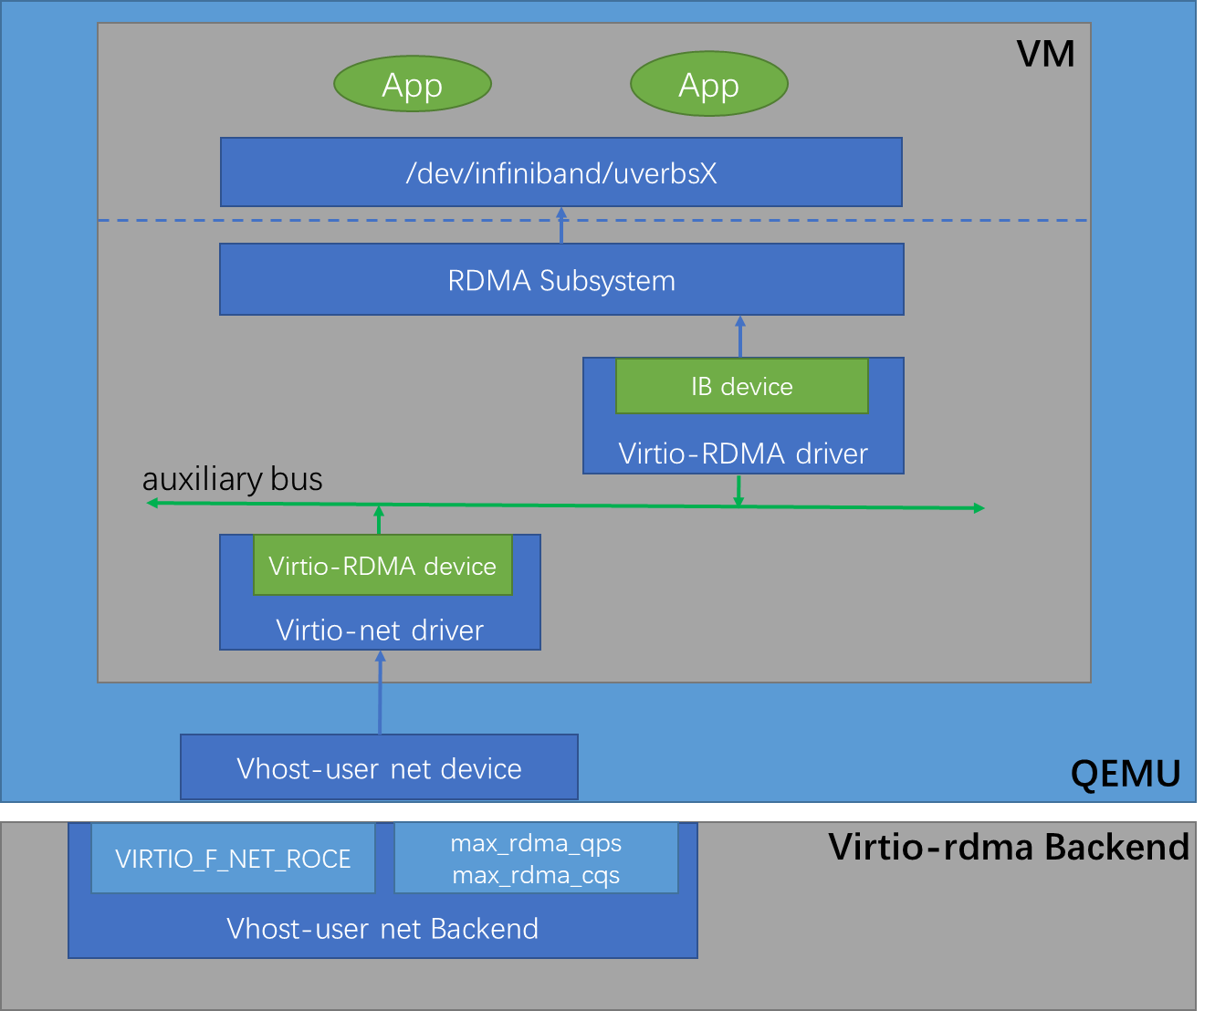
Device Initialization
New Feature bits
VIRTIO_F_NET_ROCE
New Configuration Fields
max_rdma_qps
max_rdma_cqs
Auxiliary Bus Model
Virtio-net driver create virtio-rdma auxiliary device
Virtio-rdma auxiliary driver probe virtio-rdma auxiliary device
RDMA Subsystem
Virtio-rdma auxiliary driver register an IB device to RDMA subsystem
Export char interface

Slide 14
Control Path – Create PD (Protection Domain)
Send CREATE_PD cmd via /dev/infiniband/<dev>
Send CREATE_PD cmd via ctrl queue
Alloc pd and reply pdn
Reply pdn
Get pdn
Virtio-RDMA Library
Virtio-RDMA Driver
Virtio-RDMA Backend

Slide 15
Control Path – Register MR (Memory Region)
Allocate Buffer and corresponding virt addr
Send REG_MR cmd with pdn and buffer’s virt addr via /dev/infiniband/<dev>
Pin Memory and get physical addr
Send REG_USER_MR cmd via ctrl queue
Alloc lkey, rkey, mrn and
build a mapping among lkey, mrn, phys addr and virt addr
Reply lkey, rkey and mrn
Get lkey, rkey and mrn
Virtio-RDMA Library
Virtio-RDMA Driver
Virtio-RDMA Backend

Slide 16
Control Path – Create CQ (Completion Queue)
Send CREATE_CQ cmd with queue size via /dev/infiniband/<dev>
Send CREATE_CQ cmd via ctrl queue
Find available completion queue and reply the cqn
Initialize the completion queue
Mapping completion queue into userspace
Reply cqn
Fill the completion queue
Virtio-RDMA Library
Virtio-RDMA Driver
Virtio-RDMA Backend

Slide 17
Control Path – Create QP (Send Queue & Receive Queue)
Send CREATE_QP cmd with pdn, cqn and queue size via /dev/infiniband/<dev>
Send CREATE_QP cmd via ctrl queue
Find available queue pair and bind corresponding completion queue to them.
Initialize the send queue and receive queue
Reply qpn
Mapping the send queue and receive queue into userspace
Reply qpn
Virtio-RDMA Library
Virtio-RDMA Driver
Virtio-RDMA Backend

Slide 18
Control Path – Modify QP (RC/UC Type)
Exchange dest QP’s information such as gid (global identifier) and remote qpn
Send MODIFY_QP cmd with the connection information via /dev/infiniband/<dev>
Send MODIFY_QP cmd via ctrl queue
Update the QP’s attributes to store the dest QP’s information
Virtio-RDMA Library
Virtio-RDMA Driver
Virtio-RDMA Backend

Slide 19
Data Path – Post Send
Fill send buffer
Fill send buffer and post a request to the send queue and notify device
Fetch, validate and parse the request
Follow RoCE protocol and send the buffer to dest QP
Waiting ACK if RC/UC QP, then consume an entry of the completion queue and notify the driver
Polling completion queue
Virtio-RDMA Library
Virtio-RDMA Driver
Virtio-RDMA Backend

Slide 20
Data Path – Post Receive
Post a request to the receive queue and notify device
Receive the packet and process it following RoCE protocol
Fetch, validate and parse the request and fill the packet data to the recv buffer
Consume an entry of the completion queue and notify the driver
Polling completion queue
Virtio-RDMA Library
Virtio-RDMA Driver
Virtio-RDMA Backend

Slide 21
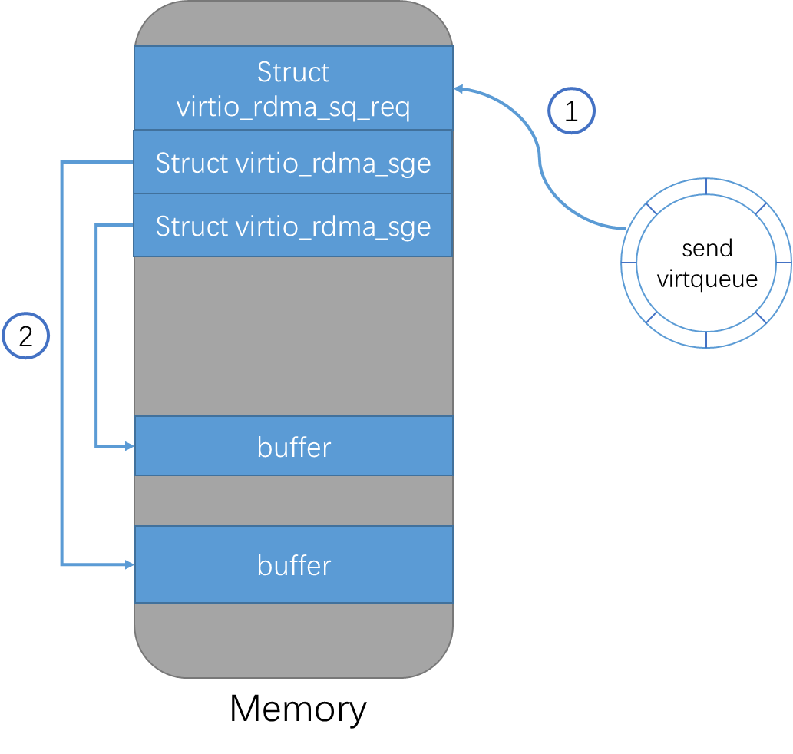
Data Path – Fetch Buffer
struct virtio_rdma_sge {
/* Start virtual address of buffer */
le64 addr;
/* Length of buffer */
le32 length;
/* Local key of buffer’s MR */
le32 lkey;
};
struct virtio_rdma_sq_req {
......
/* Length of sg_list */
le32 num_sge;
/* Scatter/gather list */
struct virtio_rdma_sge sg_list[];
};
Parse virtio descriptor to get structure virtio_rdma_sq_req and structure virtio_rdma_sge
Validate the local key and use the MR’s mapping table to translate buffer’s virtual address to its physical address.

Slide 22
Data Path – Fetch Buffer
struct virtio_rdma_sge {
/* Start virtual address of buffer */
le64 addr;
/* Length of buffer */
le32 length;
/* Local key of buffer’s MR */
le32 lkey;
};
struct virtio_rdma_sq_req {
......
/* Length of sg_list */
le32 num_sge;
/* Scatter/gather list */
struct virtio_rdma_sge sg_list[];
};
Open Issue
Multiple DMA operations for one request in data path on hardware implementation

Slide 23
Status & Future Work
S

Slide 24
Status & Future Work
Status
virtio spec patch v2 posted
- https://lore.kernel.org/all/20220511095900.343-1-xieyongji@bytedance.com/
Demo codes
- guest kernel: https://github.com/bytedance/linux/tree/virtio-net-roce
- qemu: https://github.com/bytedance/qemu/tree/vhost-user-rdma
- rdma-core: https://github.com/YongjiXie/rdma-core/tree/virtio-rdma
- vhost-user-backend: https://github.com/YongjiXie/vhost-user-rdma
Future Work
Kernel patches posted to upstream
Improve performance and get some numbers
Feature enhancement such as Base Memory Management Extensions

Slide 25
THANKS.

