Slide 1
CPU Feature Management:
Lessons from trenches
- Soham Ghosh, Shivam Kumar
September | KVM Forum 2022

Slide 2
Introduction to CPU features Modelling
CPU Feature Management | KVM Forum 2022

Slide 3
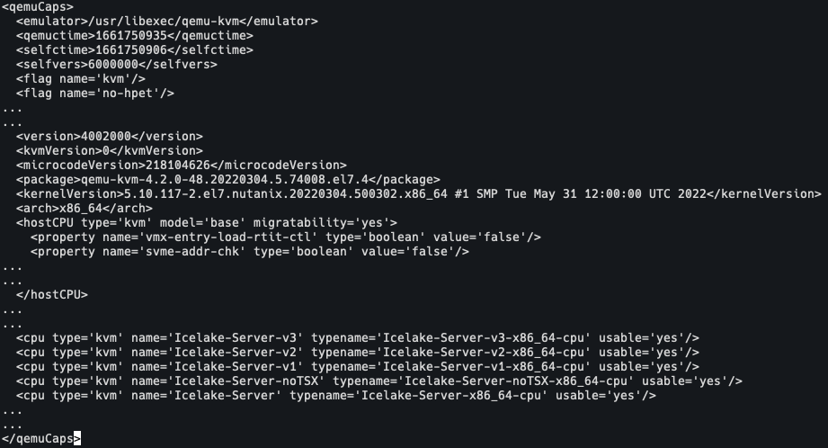
Introduction to CPU features Modelling
Libvirt Initialization:
Initializes a qemu capabilities file to store supported CPU features /var/cache/libvirt/qemu/capabilities/
CPU Feature Management | KVM Forum 2022

Slide 4
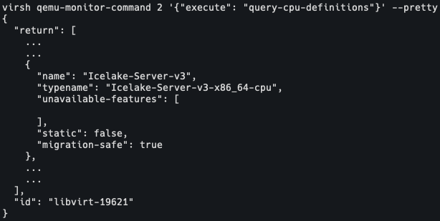
Introduction to CPU features Modelling(contd.)
Libvirt Initialization(contd.):
Invokes QMP command query-cpu-model-expansion to get the list of CPU usable/nonusable CPU features from the QEMU binary
Also it uses query-cpu-definitions QMP command to get the detailed list usable/unusable CPU models
CPU Feature Management | KVM Forum 2022

Slide 5
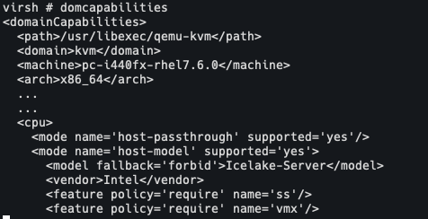
Introduction to CPU features Modelling(contd.)
Libvirt Initialization(contd.):
This cache file is loaded in memory by libvirt to give outputs for - virsh domcapabilities
Also used during qemu process launch for domain creation
CPU Feature Management | KVM Forum 2022

Slide 6
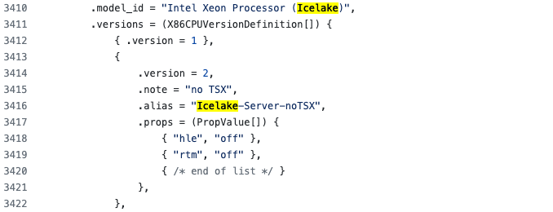
Introduction to CPU features Modelling(contd.)
Qemu CPU Definitions:
In the QEMU codebase the CPU models are defined in the file target/i386/cpu.c
CPU Feature Management | KVM Forum 2022

Slide 7
Issues Identified at Nutanix
CPU Feature Management | KVM Forum 2022

Slide 8
Feature deprecations
Pconfig:
Pconfig was a non-virtualizable feature that got accidentally added (5131d)
It was later caught and removed from Qemu (76e5a)
Qemu-3.1.0
Libvirt-4.8.0
Qemu-4.0.0
Libvirt-5.10.0
Correspondingly it got added in the cpu definition for Icelake-Server (98130)
Subsequently it was removed from libvirt as well (9cd03)
CPU Feature Management | KVM Forum 2022

Slide 9
Feature deprecations(contd…)
Pconfig(contd...):
But by then the damage was done and there's nothing we can do about migrating a VM from any host to a host with libvirt < 5.10.0 and QEMU > 3.1.0 https://bugzilla.redhat.com/show_bug.cgi?id=1749672
Could we have avoided this situation?
CPU Feature Management | KVM Forum 2022

Slide 10
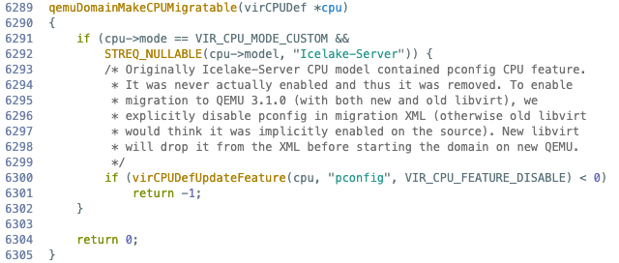
Feature deprecations(contd…)
Pconfig(contd...):
Moreover the libvirt side fix will only work if the Icelake-Server is used as custom CPU model. Won’t work if some lower base model like kvm-64 is used for maximum migratibility.
Could we have avoided this situation?
CPU Feature Management | KVM Forum 2022

Slide 11
Feature deprecations(contd…)
MPX (Memory Protection Extensions):
MPX was introduced by Intel in Skylake architecture.
But it was later identified as not very useful and hence was eventually removed (45fc2)
The mpx definition continued to stay in libvirt’s cpu definition for Icelake-Server
Intel Skylake
KVM/QEMU/ LIBVIRT
Kernel-5.6
Qemu-4.0.0
Libvirt
Correspondingly it got added in the entire virtualization stack
Subsequently it was removed from Qemu (ecb85)
CPU Feature Management | KVM Forum 2022

Slide 12
Feature deprecations(contd…)
MPX (Memory Protection Extensions):
The guest applications compiled with gcc --enable-libmpx can still complain if the feature is suddenly dropped on migration.
This resulted in virsh capabilities not identifying Icelake hosts as Icelake-Server CPU model https://gitlab.com/libvirt/libvirt/-/issues/304
CPU Feature Management | KVM Forum 2022
Notes:
mpx on source causes non-migratable vm?

Slide 13
Libvirt and Qemu tight coupling
Resulted around spectre-meltdown in nested virtualization context.
In kernel commit (29612)
Whenever Intel SPEC_CTRL and Intel STIBP bit is set, the L1 VM’s kernel expands the spec-ctrl bit to use the AMD specific bits for IBRS, IBPB and STIBP
CPU Feature Management | KVM Forum 2022

Slide 14
Libvirt and Qemu tight coupling (contd…)
On the bare-metal Icelake-Server host with libvirt-7.2.0 and qemu-4.2.0, we power on a VM in host-passthrough mode
CPU Feature Management | KVM Forum 2022
Notes:
Doesn’t show up if qemu-3.1.0 is used as it has the ibrs support from https://github.com/qemu/qemu/commit/8c80c99fcceabd0708a5a83f08577e778c9419f5
What if the users wants to disable ibrs but enable spec-ctrl? That’s not possible

Slide 15
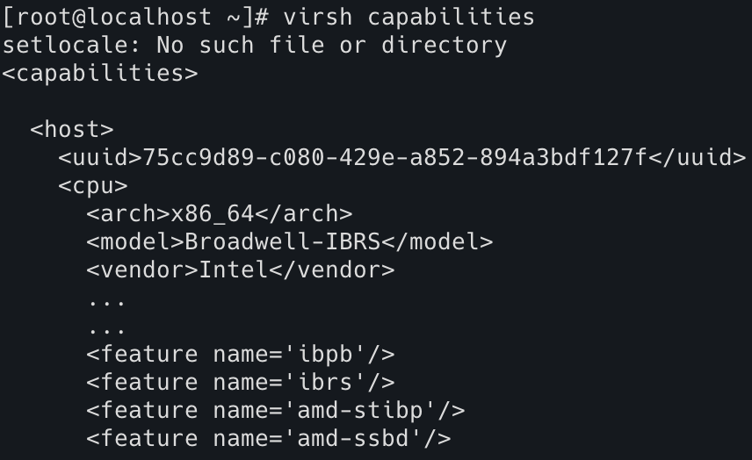
Libvirt and Qemu tight coupling (contd…)
Now inside the L1 guest the amd bits - ibrs, ibpb and stibp show up
In nested virtualization context, when libvirt-7.0.0 is running inside the L1 guest, using virsh capabilities the amd bits - ibrs, ibpb and stibp show up as extra features.
CPU Feature Management | KVM Forum 2022
Notes:
Doesn’t show up if qemu-3.1.0 is used as it has the ibrs support from https://github.com/qemu/qemu/commit/8c80c99fcceabd0708a5a83f08577e778c9419f5
What if the users wants to disable ibrs but enable spec-ctrl? That’s not possible

Slide 16
Libvirt and Qemu tight coupling (contd…)
This when passed to an older qemu for e.g qemu-2.12.0 as part of vm launch cmdline
Causes qemu to throw error saying can't apply global kvm64-x86_64-cpu.ibrs=on: Property '.ibrs' not found
This shows a clear coupling between the libvirt and QEMU versions.
Can we get out of this?
CPU Feature Management | KVM Forum 2022
Notes:
Doesn’t show up if qemu-3.1.0 is used as it has the ibrs support from https://github.com/qemu/qemu/commit/8c80c99fcceabd0708a5a83f08577e778c9419f5
What if the users wants to disable ibrs but enable spec-ctrl? That’s not possible

Slide 17
Libvirt checks for Host/Guest CPU Compatibility
Libvirt used to check host CPU features itself and used the result for both host-model and checking guest/host CPU compatibility
But it introduced a regression. Libvirt now throws error for CPU feats. Supported by host but not by QEMU
qemu: Detect host CPU model by asking QEMU on x86_64, where libvirt asked QEMU for the host CPU features and use that for validation.
Fixed in 5b4a6. Libvirt now uses union of the CPU from QEMU and from host probe for guest/host CPU compatibility
CPU Feature Management | KVM Forum 2022

Slide 18
Multiple sources of truth between libvirt and qemu
All the aforementioned issues can be root caused to one major cause
Multiple sources of CPU definitions across libvirt and QEMU
This causes the mismatch between cpu definitions across the stack
Qemu supports versioning of CPU models, whereas libvirt doesn’t give the users the freedom to choose model versions.
Increases the development time and complexity.
CPU Feature Management | KVM Forum 2022

Slide 19
Proposed Fix
CPU Feature Management | KVM Forum 2022

Slide 20
Problem Statement
Qemu supports multiple versions for a single cpu model generation. For e.g Icelake-Server has got 6 versions
Even virsh domcapabilities simply gives us the base cpu model name without the versions.
Libvirt doesn’t get to choose the version and only passes the base model name
The version is decided by the qemu machine-type.
CPU Feature Management | KVM Forum 2022

Slide 21
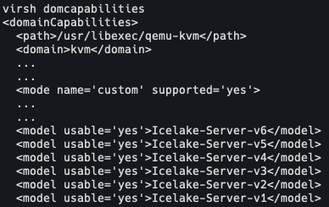
Proposed Fix
Libvirt to rely completely on QEMU cpu models.
Expose the different usable versions for cpu models in virsh domcapabilities
CPU Feature Management | KVM Forum 2022
Notes:
Why should libvirt compare it with the fullCPU list generated from union of qemu cpu definitions and cpuid. Instead compare with qemu reported CPU list

Slide 22
Proposed Fix(contd…)
Users can mention the cpu model version in domain xmls which will be passed to the qemu process launch cmdline.
Skip validation of CPU definitions in libvirt. This will remove the dependency on libvirt for host/guest CPU compatibility.
Instead introduce a new check “hypervisor” in libvirt to set enforce flag in qemu cmdline. This will delegate the CPU model and version check to qemu
CPU Feature Management | KVM Forum 2022
Notes:
Why should libvirt compare it with the fullCPU list generated from union of qemu cpu definitions and cpuid. Instead compare with qemu reported CPU list

Slide 23
How does the fix work?
Gives common CPU models and versions for both libvirt and qemu
Issues around Pconfig deprecation can be avoided now that libvirt can directly use the qemu models with versions. So CPU features can be deprecated via model versions
Libvirt no longer needs to maintain the responsibility of guest and host cpu compatibility check
CPU Feature Management | KVM Forum 2022

Slide 24
Limitations
The approach only works for libvirt-QEMU stack. It doesn’t cover other drivers
Not the answer to all the CPU features issues that we face. For e.g- tight-coupling is still not resolved
CPU Feature Management | KVM Forum 2022

Slide 25
Conclusion
CPU Feature Management | KVM Forum 2022

Slide 26
Conclusion
The purpose of the talk was to pique the interest of the community in looking at issues around design and maintenance of CPU models
As part of it we have tried to come up with a solution that simplifies the CPU model handling workflow across libvirt and qemu.
Looking forward to sending out patches and feedback on the proposal
CPU Feature Management | KVM Forum 2022

Slide 27
Thank you

Slide 28
Virsh Capabilities vs Domcapabilities
In the old days (ie before 2018 and spectre issues), libvirt and qemu had a nice set of named CPU models that corresponded to different Intel/AMD physical CPU families/generations
An application could query libvirt to determine what the host CPU model was/is using virsh capabilities and use that model name in the guest XML and be fairly happy.
Post Spectre, QEMU introduced several new models with CPU flags for mitigations
And users were asked to move to virsh domcapabilties to use supported/virtualizable CPU models for any host
TITLE OF PRESENTATION | CONFIDENTIAL

Slide 29
Feature renaming (Tentative)
arch-facilities vs arch-capabilities
arch-facilities cpu features was introduced in a local patch for qemu from redhat to expand MSR features
It was not supported in upstream qemu and kernel
Later similar feature was introduced by kernel and qemu-2.12.0 and was called as arch-capabilities.
We can’t upgrade our older qemu version to > 2.12.0 as that will make the VMs non-migratable.
So we need to maintain a lifetime patch of renaming arch-capabilities back to arch-facilities.
CPU Feature Management | KVM Forum

Slide 30
VM power on workflow at Nutanix
Queries host/nodes to know their capabilities using virsh capabilities.
Gets the latest model closest to the host
Gets extra features not supported by the host.
Performs custom baselining of features across hosts
Passes the baselined set of features with kvm64 model to the libvirt domain xml during VM power on.
TITLE OF PRESENTATION | CONFIDENTIAL

Slide 31
Our Team
Manish Mishra <manish.mishra@nutanix.com>
Prachatos Mitra <prachatos.mitra@nutanix.com>
Prerna Saxena <prerna.saxena@nutanix.com>
Rohit Kumar <rohit.kumar3@nutanix.com>
Shivam Kumar <shivam.kumar@nutanix.com>
Soham Ghosh <soham.ghosh@nutanix.com>
CPU Feature Management | KVM Forum 2022

