Slide 1
Exploring Intel Subpage-Protection(SPP) in context of Live Migration
August | KVM Forum 2022

Slide 2
Agenda slide
1
Introduction
2
Using SPP for live migration
3
Results
4
Challenges and Future Work
5
Conclusion
August | KVM Forum 2022

Slide 3
Introduction
August | KVM Forum 2022

Slide 4
Introduction
Have you ever waited for an “eternity” for a live migration to finish?
Non-converging live migrations is a frustrating experience
A live migration may not converge if the network is not able to catch up with the rate at which the guest is dirtying the memory. This can happen:
either the guest is simply dirtying too heavily
or because the network throughput is low enough; very frequent in migrations across WAN
Let’s focus on the “low network throughput” case and ask - “What can we do about it?”
August | KVM Forum 2022

Slide 5
Let’s focus on the “low network throughput” case and ask - “What can we do about it?”
Well, we could compress the guest data and then send it over the network.
But how effective is it?
By what degree can we compress the guest data - it totally depends on the data itself
What about the CPU cycles wasted by the compression algorithm or the memory footprints - it can be pretty CPU intensive or memory intensive
Let’s open the box of new hardware features available on newer processor generations and see if something can help us here.
How about Intel’s sub-page write-permission feature?
August | KVM Forum 2022

Slide 6
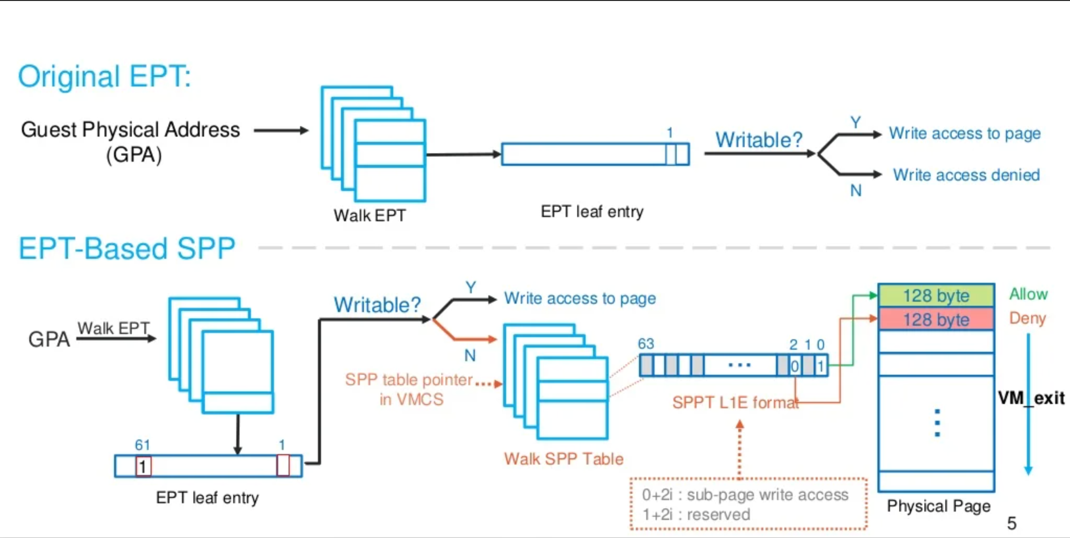
What is Intel’s sub-page write-permission feature? - [3]
August | KVM Forum 2022

Slide 7
What is Intel’s sub-page write-permission feature?
EPT-Based Sub-Page write Protection(SPP) allows Virtual Machine Monitor(VMM) specify write-permission for guest physical memory at a sub-page(128 byte) granularity.
When SPP works, HW enforces write-access check for sub-pages within a protected 4KB page.
SPP is active when the "sub-page write protection" (bit 23) is 1 in Secondary VM-Execution Controls. The feature is backed with a Sub-Page Permission Table(SPPT), and subpage permission vector is stored in the leaf entry of SPPT. The root page is referenced via a Sub-Page Permission Table Pointer (SPPTP) in VMCS.
SPP Page Faults will still trigger EPT VIOLATION but for SPP Page Table Misconfigs there is new VM Exit reason SPPT Misconfig.
SPP is supported only for 4K PTEs and works with only write-protection so can not use PML.
August | KVM Forum 2022

Slide 8
Using SPP for live migration
Why use sub-page protection for live migration?
Will be very helpful in low network bandwidth cases. How?
A live migration converges if, after certain migration iteration, we are left with a dirtied memory that can be transferred within the expected downtime.
The amount of memory we can transfer during this expected downtime is proportionate to the network throughput.
With low network throughput, this amount is significantly low.
We can reduce the dirtied memory with the SPP support for live migration by a factor of (1-32) depending on the workload.
August | KVM Forum 2022

Slide 9
KVM Support For SPP
August | KVM Forum 2022

Slide 10
Support for sub-page protection in kernel
Thanks to Yang Weijiang, we have the following support[1] at our exposure:
SPPT setup/ capability.
User-space SPP IOCTLs for set/get SPP Permissions.
Routines to SPP protect/unprotect memory ranges.
Handling SPP misconfig induced vmexits and setting up SPP page tables.
Modifying page-fault handlers to update SPP bit as per SPP protection on the GFN.
Lazy mode initialisation of EPT as well as SPPT page-tables.
August | KVM Forum 2022

Slide 11
What we added to support live migration with sub-page level dirty tracking?
Kernel:
Rebasing the patches on the kernel 5.10 (a lot has changed in the kernel mmu code since the last iteration of review).
Not yet rebased for TDP MMU which is now default in upstream.
Fixing miscellaneous bugs found while evaluating the base patches.
Integrating with Enable/Disable/Clear/Get dirty IOCTL.
Manipulating Bitmaps for Subpage/Page Level dirtying.
Disabling SPP on subpage in fast page fault once a page is already dirtied once until next GET_DIRTY_LOG or CLEAR_DIRTY_LOG.
Optimising tlb flushes, by doing batching of tlb flushes and bringing it out of critical locks.
Other small fixes like handling vcpu and memory hotplug on SPP enabled VM.
August | KVM Forum 2022

Slide 12
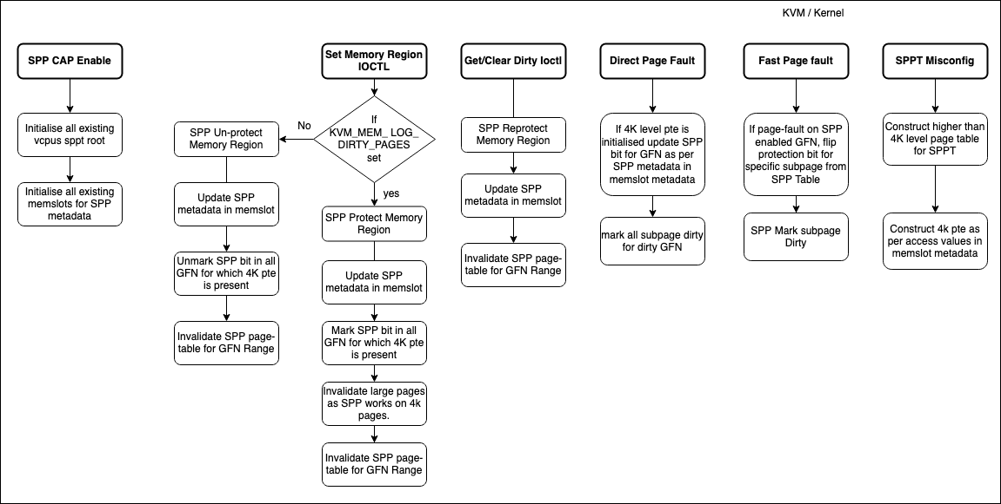
KVM Side Workflow
August | KVM Forum 2022

Slide 13
Qemu Support For SPP
August | KVM Forum 2022

Slide 14
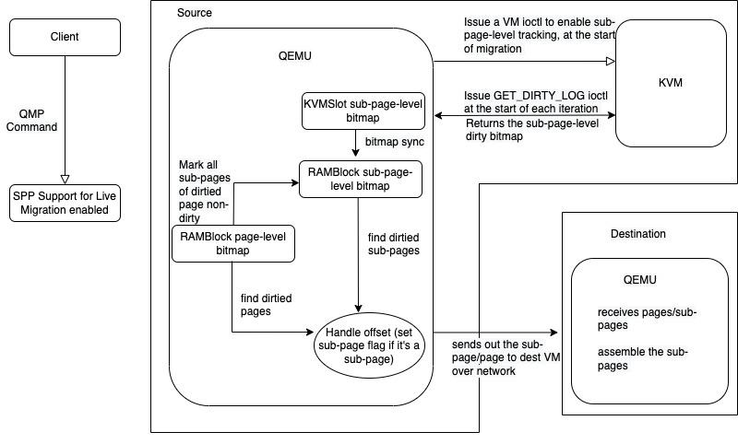
QEMU Side Workflow
August | KVM Forum 2022

Slide 15
What we added to support live migration with sub-page level dirty tracking?
QEMU:
Create/Manage separate Bitmap for SPP to remove multiple copies for bitmaps for SPP registered memory regions.
Handling transmission and assembling of sub-pages.
August | KVM Forum 2022

Slide 16
Results
August | KVM Forum 2022

Slide 17
Preliminary Results
Workloads we have used for benchmarking
Nutanix PC-VM
Kernel build process
How do we evaluate the gains or losses with SPP?
Observe memory access patterns (only writes). How?
Measure the reduction in data to be transferred across live migration with SPP support.
Measure the impact on network due to the overhead of transferring data at sub-page granularity.
Improvement in Time to Migrate.
Note*: Our implementation on day this video is recorded is still not very stable so some of the data is estimated from offline calculations.
August | KVM Forum 2022

Slide 18
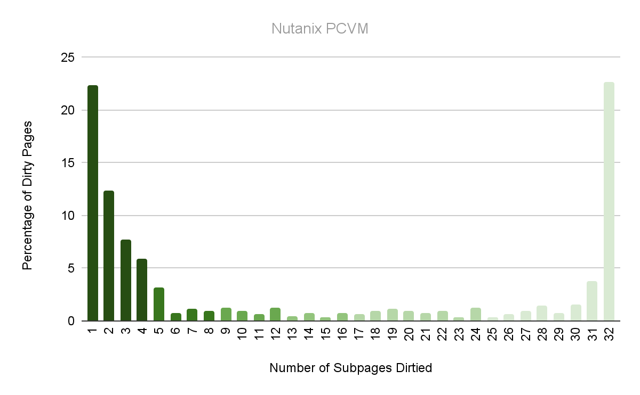
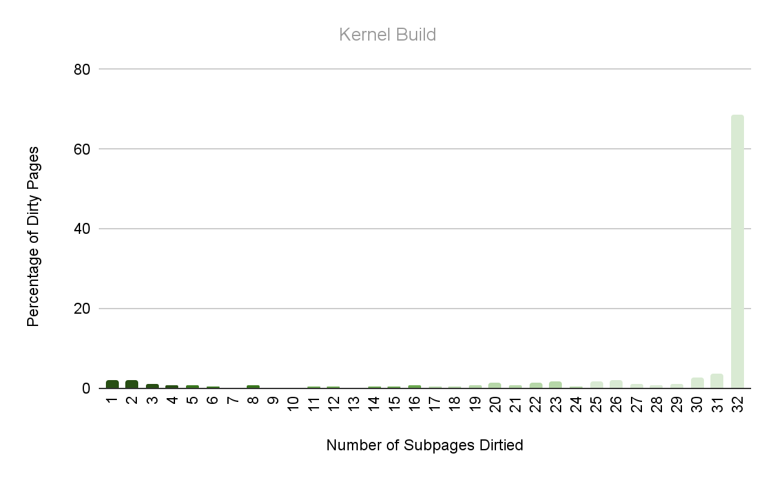
Memory Access Patterns
August | KVM Forum 2022

Slide 19
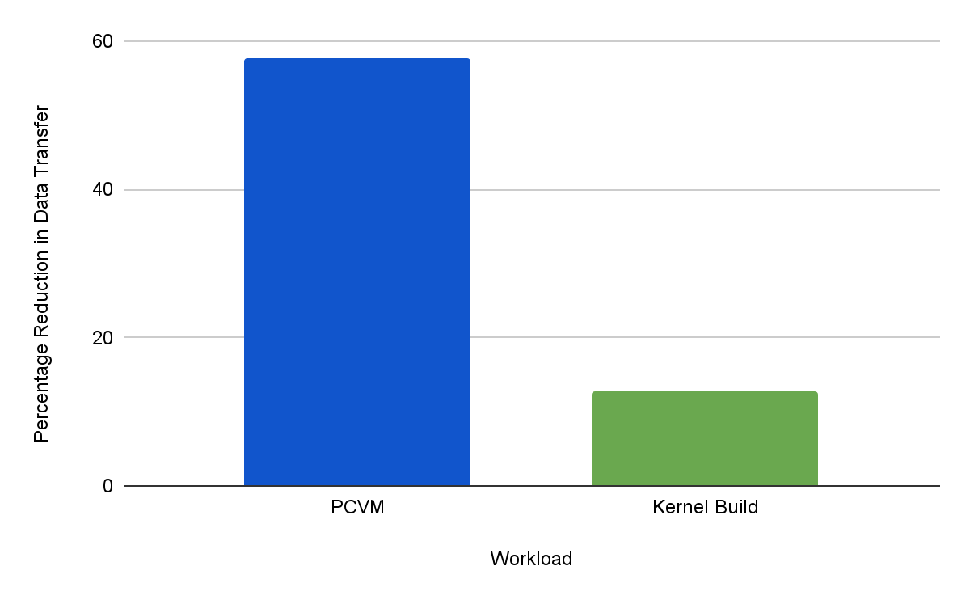
Percentage Reduction in Data Transferred
August | KVM Forum 2022

Slide 20
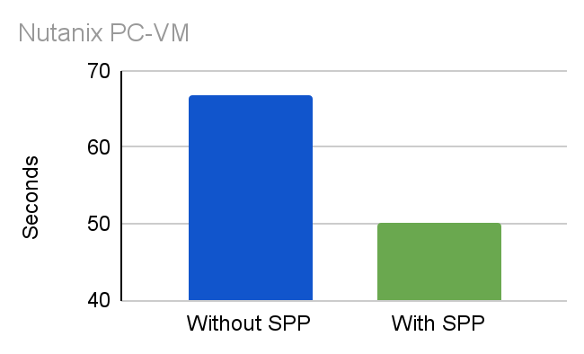
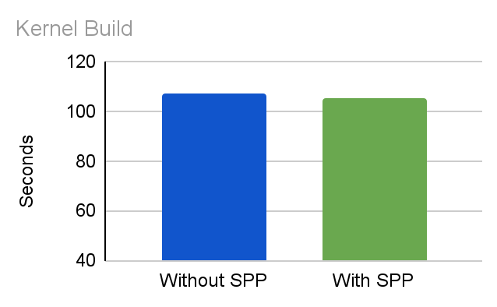
Overall Gain
Time to Migrate
August | KVM Forum 2022
Notes:
We eventually compare live migrations with and without SPP on the basis of total migration time. We see a significant decrease in total migration time for the PCVM and a minor improvement for the kernel build process.

Slide 21
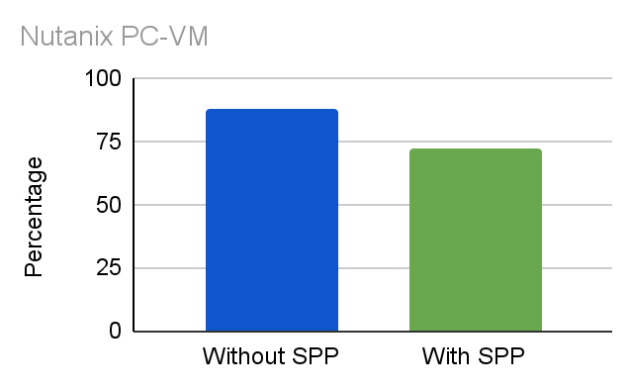
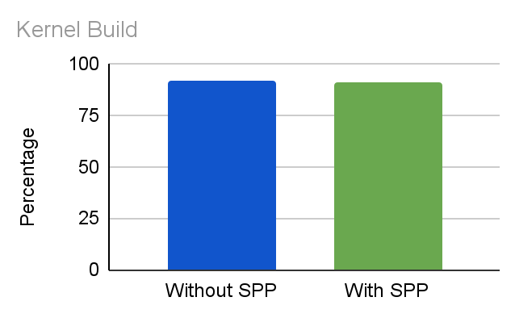
Throttle rate
August | KVM Forum 2022

Slide 22
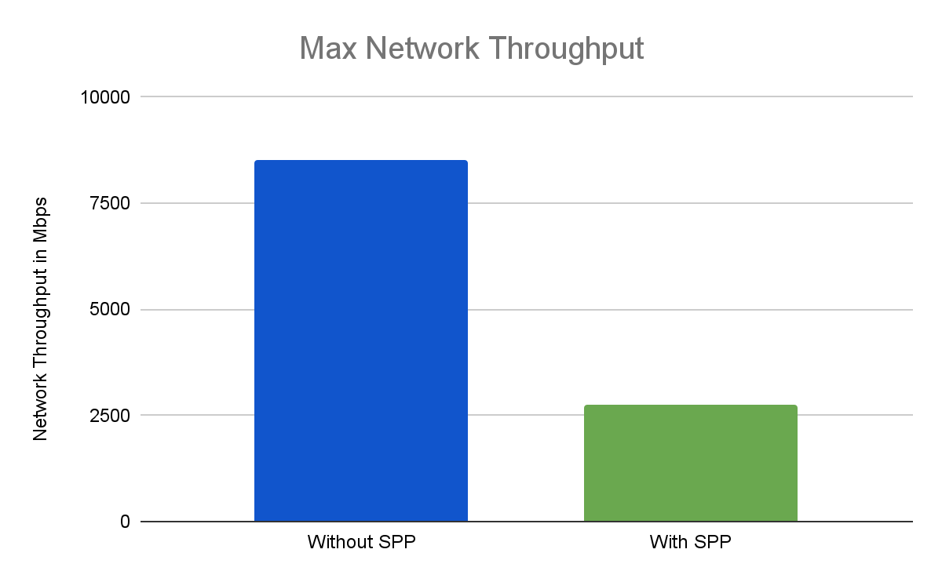
Limitations of SPP in live migration context
Not very effective in high network throughput cases
there is gain in data reduction
but it is overpowered by decrease in network throughput due to overhead in data transfer at sub-page level granularity
May not be effective for multi-fd; cpu utilization may shoot up.
Not for zero-copy; can’t transfer sub-page.
August | KVM Forum 2022

Slide 23
Challenges and Future Work
August | KVM Forum 2022

Slide 24
Challenges
Memory Overhead
32 times larger bitmap with SPP and extra SPP page-tables.
Can be huge for large memory VMs.
Overhead in bitmap sync due to large bitmap size(also holding mmu lock for longer period)
Impact on guest performance
Upto 32 times more vmexits with sub-page-level dirty tracking.
PML(Page Modification Logging) not supported with SPP.
August | KVM Forum 2022

Slide 25
* on Redis benchmark ^{[4]}
Latency
Throughput
Impact on Guest Performance
 | Without SPP | With SPP
Avg | 0.456 | 28.501
Min | 0.168 | 4.648
P50 | 0.415 | 23.919
P95 | 1.223 | 42.847
P99 | 1.351 | 148.735
Max | 11.167 | 431.359
 | Without SPP | With SPP
Throughput (requests per second) | 79744.82 | 1503.78
August | KVM Forum 2022

Slide 26
Conclusion
How can SPP help?
SPP can help converge those edge cases where migration gets stuck because the network bandwidth is not good enough (for workloads dirtying not more than a few subpages in a page) .
Current status of our work
There’s ongoing work on optimising the implementation (to be discussed in the later slides)
The current implementation needs more testing
Kernel and QEMU patches for live migration soon
August | KVM Forum 2022

Slide 27
Future Work
How to counter the problem of large bitmap size and guest performance?
Increasing the granularity of dirty tracking to group of consecutive sub-pages, e.g. 4 consecutive subpages or 512 bytes
Selective dirty tracking with SPP, e.g.
Start with dirty tracking with SPP
After a few contiguous subpages dirtied within the same page, switch to page-level dirty tracking for the page
Hashmap-based dirty tracking for subpages
Reducing the number of Bitmaps maintained by QEMU further.
Memory footprints decrease, time overhead in bitmap sync reduced
Integration with Dirty Ring can reduce bitmap sync time and remove memory overhead of Kernel copy of Bitmap.
August | KVM Forum 2022

Slide 28
Future Work
How to counter the problem of large bitmap size and guest performance?
We are majorly focusing on the below two ideas:
Dynamically assess a live migration to determine if subpage protection makes sense and enable it
Dynamically determine the optimal subpage-protection granularity
Both of these decisions are based on the two key metrics which we have discussed:
Memory access pattern
Impact on network throughput
August | KVM Forum 2022

Slide 29
References
https://lwn.net/Articles/820748/
https://www.os.ecc.u-tokyo.ac.jp/papers/2021-cloud-ozawa.pdf
https://www.slideshare.net/xen_com_mgr/xpdds18-eptbased-subpage-write-protection-on-xenc-yi-zhang-intel
https://redis.io/docs/reference/optimization/benchmarks/
August | KVM Forum 2022

Slide 30
Our Team
Soham Ghosh <soham.ghosh@nutanix.com>
Tejus GK <tejus.gk@nutanix.com>
Shivam Kumar <shivam.kumar@nutanix.com>
Manish Mishra <manish.mishra@nutanix.com>
Prachatos Mitra <prachatos.mitra@nutanix.com>
Prerna Saxena <prerna.saxena@nutanix.com>
Carl Waldspurger <carl.waldspurger@nutanix.com>
August | KVM Forum 2022

Slide 31
Thank you

