Slide 1
Live Migration through Micro Stunning Virtual Machines
Manish Mishra <manish.mishra@nutanix.com>
Shivam Kumar <shivam.kumar1@nutanix.com>

Slide 2
Agenda
1
Background
2
Design and Implementation
3
Results
4
Conclusion and Future Work

Slide 3
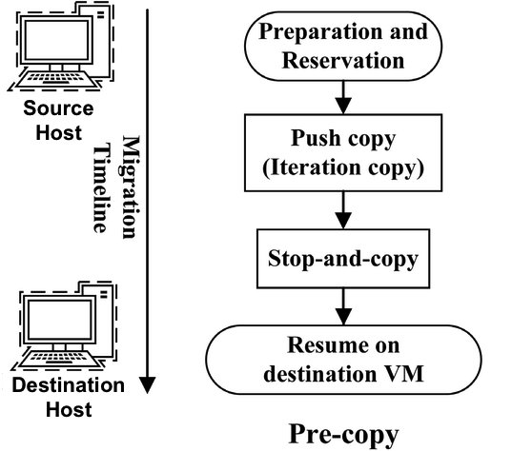
Background
Pre-copy migration scheme
One of the popular live migration schemes
Can tolerate destination host’s failure
How to track whether a page got dirtied? Dirty Bitmap Limitations of Standard Pre-copy:
Non-converging migrations
Long migrations
Source

Slide 4
Background
What would be a straightforward way to reduce dirtying?
Sleep the vCPUs for a given percent of time so that
process(es) dirtying the memory get less cpu execution time
and thus are prevented to dirty more pages
Limitations of current throttling logic:
Throttles all vCPUs of the VM, “read processes” unnecessarily penalized.
Doesn’t converge even with maximum(99%) throttling.
No throttling during the bulk phase of migration.
Struggles to find the optimal throttle. Time wasted.
Migration iteration level granularity. Slow to respond to workload changes.
Notes:
May start with low throttling
x = x * total bytes transferred)/(2*total bytes dirtied)) Throttle rate = (1 - x)
Fundamentally flawed, does not take into account time to dirty.
99% throttling: Sleeping the vCPU for 990ms for every 1000ms in order to converge the migration.

Slide 5
Design and Implementation
Until now, pre-copy migration scheme has been about throttling the guest OS unconditionally. From now on, we will adaptively micro-stun VMs. How?
Start with an appropriate limit on dirty rate which can ensure convergence.
Dirty Rate Limit = Network Throughput / X
Iter | 1 | 2 | 3 | 4 | 5 | 6 | 7 | 8 | ...
Copied | 16GB | 16GB/X | 16GB/X² | 16GB/X³ | 16GB/X⁴ | 16GB/X⁵ | 16GB/X⁶ | 16GB/X⁷ | ...
Dirtied | 16GB/X | 16GB/X² | 16GB/X³ | 16GB/X⁴ | 16GB/X⁵ | 16GB/X⁶ | 16GB/X⁷ | 16GB/X⁸ | ....

Slide 6
Design and Implementation
Example: A VM with 16GB memory, 1GBps network bandwidth, Dirty rate limited to 0.5GBps
How many iterations? -> How much downtime you can afford?
Iter | 1 | 2 | 3 | 4 | 5 | 6 | 7 | 8 | ...
Copied | 16GB | 8GB | 4GB | 2GB | 1GB | 0.5GB | 0.25GB | 0.125GB | ...
Dirtied | .5GBps x 16s = 8GB | .5GBps x 8s = 4GB | .5GBps x 4s = 2GB | .5GBps x 2s = 1GB | .5GBps x 1s = .5GB | .5GBps x .5s = .25GB | .5GBps x .25s = .125GB | .5GBps x .125s = .0625GB | ....
Time | 16s | 8s | 4s | 2s | 1s | 500ms | 250ms | 125ms | ...

Slide 7
Design and Implementation
How can we enforce the limit on dirty rate aka Dirty Rate Limit?
Force the VM’s average dirty rate to be less than this limit within fixed size time windows.
What interval should we choose to limit the average dirty rate?
Smaller time window -> more adaptive throttling.
Smaller time window -> smaller bound on sleep time.
Smaller time window -> better guest performance
Smaller time window -> less accuracy of sleep and reschedule

Slide 8
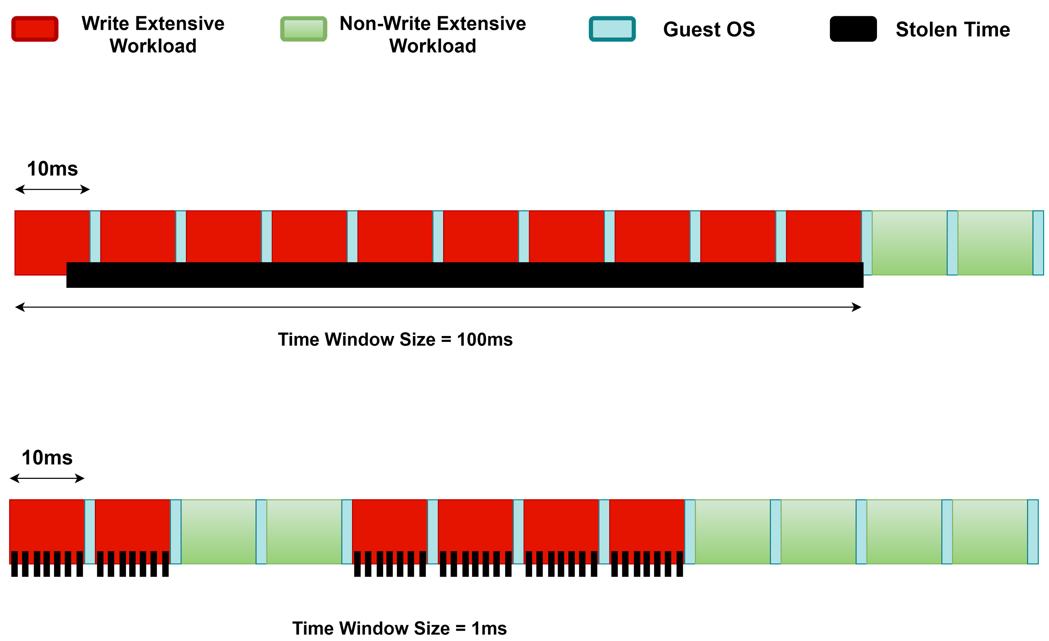

Slide 9
Design and Implementation
How do we avoid unnecessary throttling of vCPUs?
Selectively throttle vCPUs by enforcing the limit per vCPU.
Limit on number of pages dirtied by individual vCPUs (dirty quota):
Dirty Quota = (Dirty Rate Limit x Time Window) / NUM_VCPUS
Live Migration through micro-stunning Virtual Machines

Slide 10
Design and Implementation
How do we deal with skewed cases (some vCPUs are just writing, some are just reading)?
Quota is added to a common pool if not consumed by the vCPU
Common pool is fairly accessible to all vCPUs
Common pool can be consumed from only when:
the vCPU has used its dirty quota for the current window
the vCPU needs more quota

Slide 11
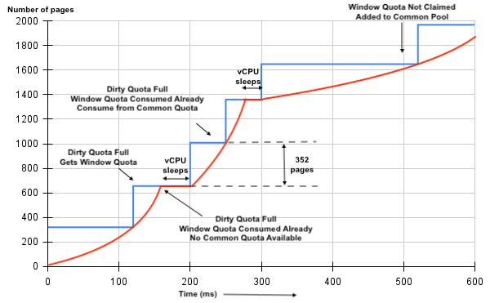
Design and Implementation
Cumulative value of dirty quota
Number of pages dirtied by the given vCPU
352 pages? Assume Network Throughput = 220 MBps, NUM_VCPUS = 8
Dirty Rate Limit = Network Throughput / X = 220 MBps / 2 = 110 MBps
Dirty Quota = (Dirty Rate Limit x Time Window) / NUM_VCPUS = (110 MBps x 100 ms) / 8 vCPUs = 1408 KB/vCPU = (1408/4) pages/vCPU = 352 pages/vCPU

Slide 12
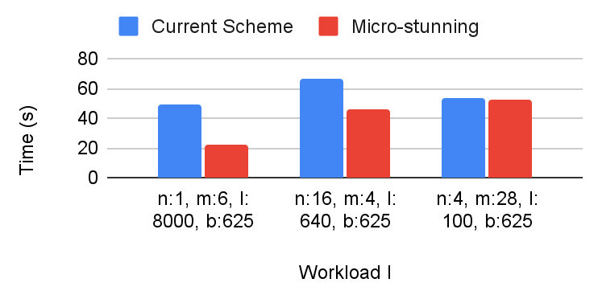
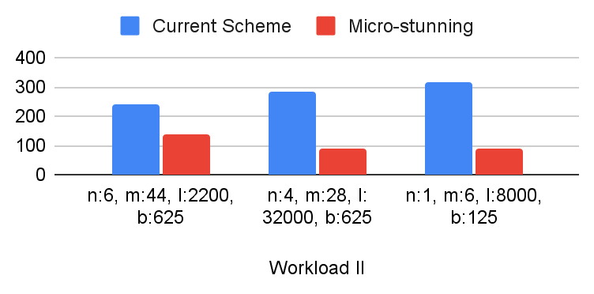
Results
n: x; m: y; l: z; b: p; means x threads dirtying y GB of memory at the rate of z MBps and network bandwidth is p MBps
Benchmark results for convergence and total migration time
Reduced By
56.02% | 31.35% | 0.26%
42.59% | 68.38% | 71.63%

Slide 13
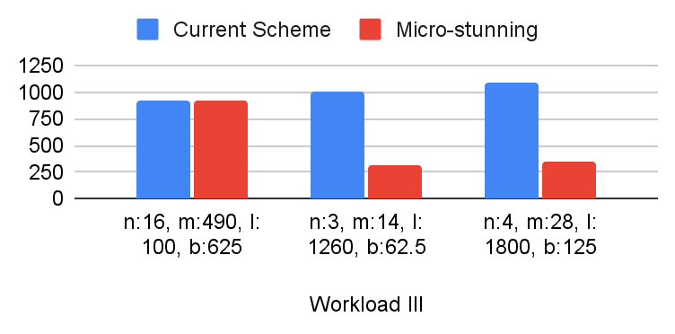
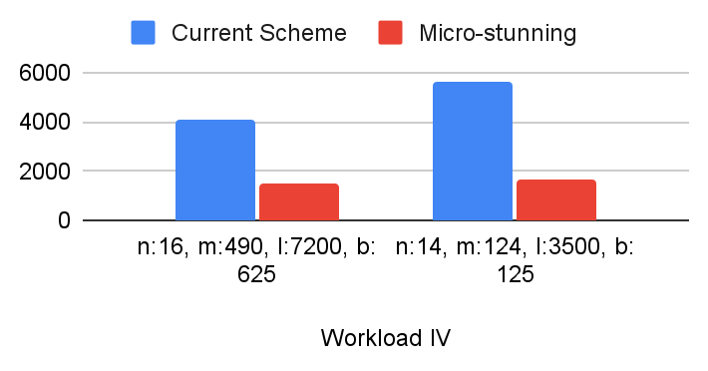
Results
n: x; m: y; l: z; means x threads dirtying y GB of memory at the rate of z MBps
Benchmark results for convergence and total migration time
Reduced By
0.50% | 68.56% | 67.55%
63.40% | 70.83%

Slide 14
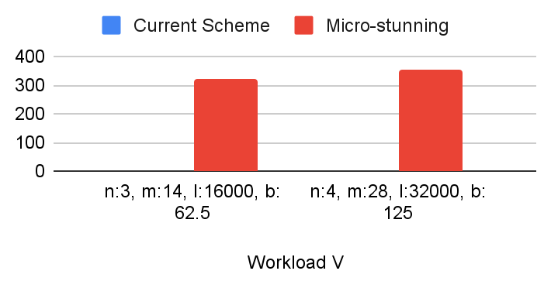
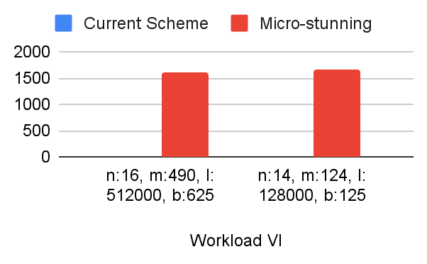
Results
n: x; m: y; l: z; means x threads dirtying y GB of memory at the rate of z MBps
Benchmark results for convergence and total migration time
Migration Didn’t Converge
Migration Didn’t Converge
Migration Didn’t Converge
Migration Didn’t Converge

Slide 15
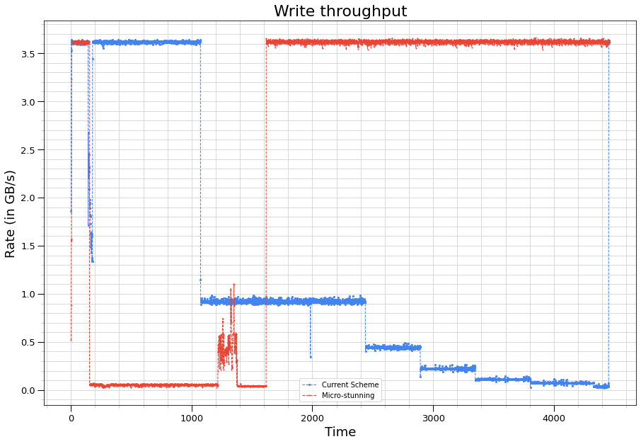
Results
Comparing guest performance in terms of write throughput
Scenario VM: 128 GB memory, 32 vCPUs, 128 MBps network bandwidth
Workload:
Dirtying 62 GiB with 7/16 CPUs (limited at ~3500 MB/s),
Reading 62 GiB with 7/16 CPUs (limited at ~3500 MB/s)

Slide 16
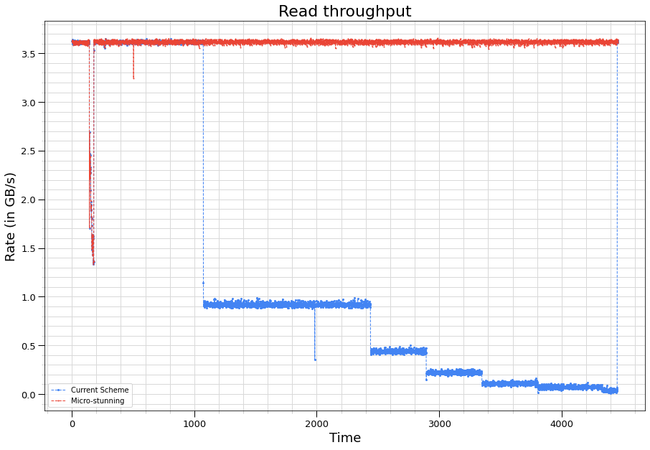
Results
Comparing guest performance in terms of read throughput
Scenario VM: 128 GB memory, 32 vCPUs, 128 MBps network bandwidth
Workload:
Dirtying 62 GiB with 7/16 CPUs (limited at ~3500 MB/s),
Reading 62 GiB with 7/16 CPUs (limited at ~3500 MB/s)

Slide 17
Conclusion
Remarkably improves guest performance during live migration.
Significantly reduces total migration time.
Ensures convergence in extremely write-intensive workloads.
Adaptive to network bandwidth and workload changes.

Slide 18
Future Work
Migration failure conditions.
Merging the code.
Optimising the micro-stun.
Experiments on real workloads.
Predictability.

Slide 19
Thank you
Manish Mishra
manish.mishra@nutanix.com
Anurag Madnawat
anurag.madnawat@nutanix.com
Shivam Kumar
shivam.kumar1@nutanix.com

